Slide 1
Welcome to 4th-5th Grade
Back to School Night at Walnut Elementary!
Presented by:
Mr. McKellip

Slide 2
Communication:
Our Class Website http://www.chino.k12.ca.us/Domain/1204
E-mail: robert_mckellip@chino.k12.ca.us
Phone: (909) 627-9817 x3715
Appointments
  Before or After School
  Advance Notice Required by Email (best) or Phone Call

Slide 3
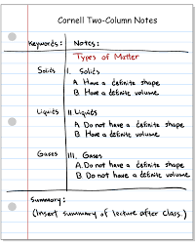
AVID Elementary
Advancement
Via
Individual
Determination

Slide 4
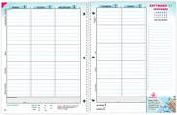
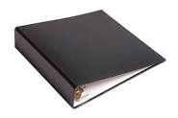
AVID Focus in 4th-5th Grade
Agenda: All Daily Classwork assigned for every day
Binders: Agenda, Important Papers, School Supplies, Classwork/Homework
Notes: 2-column note taking

Slide 5

Behavior Expectations
We will follow school rules.
We will follow classroom procedures.
We will show respect at all times.
We will keep our hands, feet, and items to ourselves.

Slide 6

Consequences
Expected behavior: Pack Points, Leader of the Pack Note, Participation in all class activities, Verbal Praise, Class rewards.
Poor Choices:
1st Ticket - Warning
2nd Ticket - Work in Progress Note
3rd Ticket - Telephone call or email home
4th ticket – Office referral
It is possible to receive an Office referral for a serious incident (physical fighting, bullying, bringing a weapon to school, etc.)

Slide 7

Classwork → Homework
Every lesson/topic is started in class.
Students are given time in class to start work from the lesson and get help if they don’t understand something.
If students do not complete the lesson’s work in class, it becomes homework.
I will call home if a student misses more than 2 assignments a week!!!

Slide 8
Tests/Projects
All concepts taught in class will be tested or assigned as a project.
Any missed tests will be given during class time as needed.
Concepts may be retaught and retested if needed
Projects will be assigned on Google Classroom with what is expected and a due date.

Slide 9

Report Card Grades
1= Beginning: Standard Not Met
2= Progressing: Standard partially met
3= Achieving: Standard consistently met
4= Extending: In depth understanding of
the concept

Slide 10
Important Dates: 4th
Parent-Teacher Conferences:
September 16-20, 2024
1st Field Trip: Mission San Juan Capistrano
Monday, November 4, 2024
2nd Field Trip: The Cube
Probably February-March

Slide 11
Important Dates: 5th
Parent-Teacher Conferences:
September 16-20, 2024
D.A.R.E.
Starts Thursday, October 3, 2024
1st Field Trip: Skate Express
Sometime in November
2nd Field Trip: Possible, but not definite.

Slide 12
Questions

